Slide 1

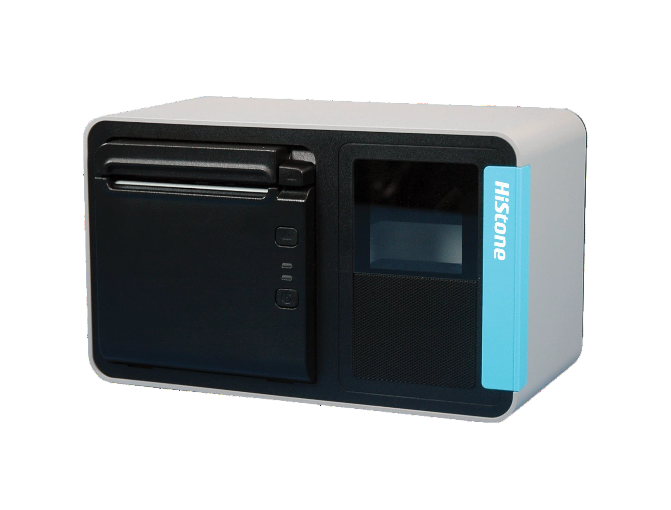
Peripherals | CubeX
Key Features
Integrated 80mm Printer and 2D scanner for space saving solution；
Printer can be rotated 90° for CubeX different placement way;
2 kinds of Scanner optional for Mobile payment or goods barcode
Loud speaker suitable for noisy situation；
QINGDAO HISTONE INTELLIGENT COMMERCIAL SYSTEM CO.,LTD.
Wisdom Valley,NO.8 Shengshui Road, Laoshan District, Qingdao City, China.
Tel: +86 (532) 66069168
infopos@histonetec.com www.hics.histonetec.com

Slide 2
MODEL |  | CubeX
Type |  | CubeX for HK316 /CubeX for HK560 (IC different)
Speaker(optinal) |  | 10W
IO Ports |  | 24VDC-IN
 |  | USB2.0*1
 |  | Audio line-out*1
 |  | RJ48 With flow control *1
 |  | RJ11 for cash drawer*1
Printer |  | Separate 80mm thermal printer
 |  | Interface: USB2.0(full speed)
 |  | Paper width: 80 mm/58 mm
 |  | Printing speed: Maximum of 200 mm/s
 |  | Paper roll OD: Maximum of 83 mm
Scanner |  | 2 kind scanners optional
 |  | Small Scanner for mobile payment barcode only | Big Scanner for both mobile payment barcode and goods barcode
 |  | Field of View: Horizontal: 140°, Vertical: 99° | Field of View: Horizontal 51°, Vertical 32°
 |  | Scanning Angles: ±58°, ±65°, 360° (skew, pitch, roll) | Scanning Angles: ± 45°, ±50°,360° (skew, pitch, roll)
 |  | Minimum Resolution: 10 mil | Minimum Resolution: ≥3mil
 |  | Interfaces: TTL-232, or USB HIB Keyboard, USB virtual COM | Interfaces: RS-232, USB
Product dimensions（ H*W*D） |  | 150*153*252mm
Package dimensions（ H*W*D） |  | 210*200*300mm
Gross weight |  | 2.4kg(small scanner version) |  | 2.7kg(big scanner version)
net weight |  | 2kg(small scanner version) |  | 2.3kg(big scanner version)
Printer Tilt Adjustment |  | 0°- 90°（Vertical）
Operating Voltage |  | 100V~240V
Environmen t | Operating | 5℃ - 40℃/10%-90% RH non-condensing
 | Storage | -10℃ - 70℃/10%-90% RH non-condensing
EMC and Safety |  | FCC /CE / RoHS
Colour |  | Black/White

Slide 3

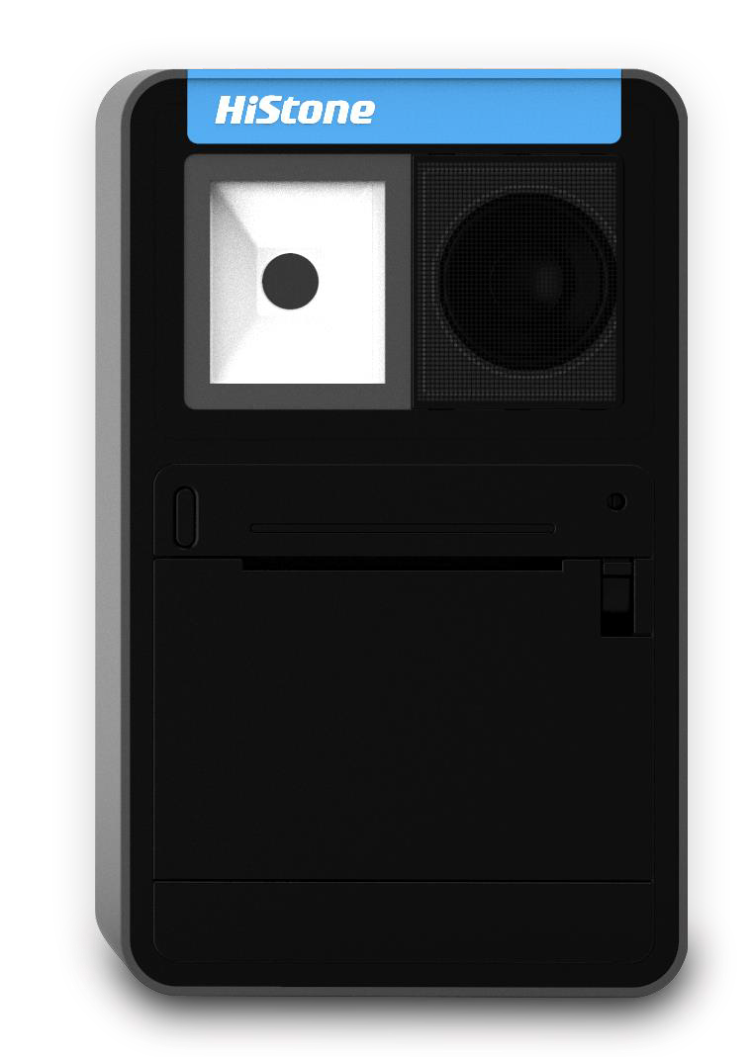
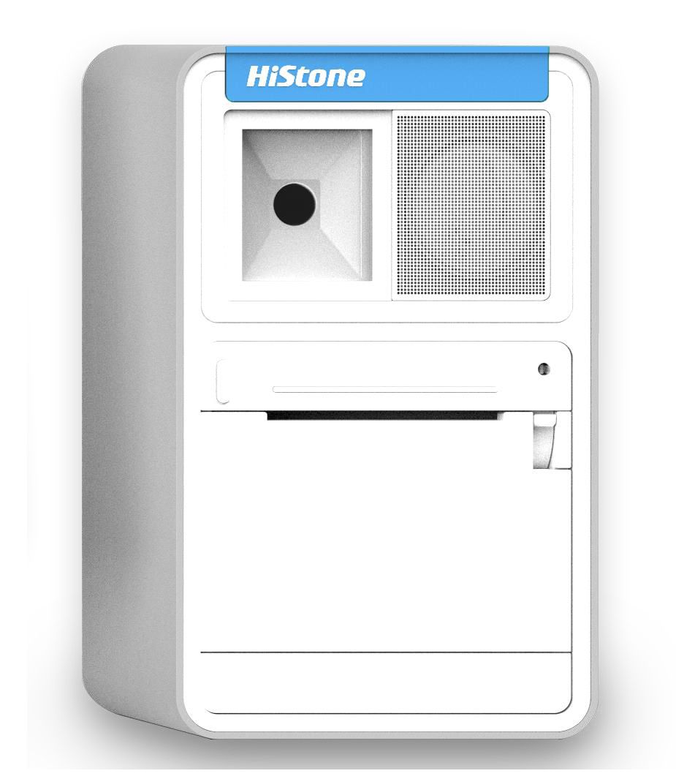

Black or White color optional
Optional speaker
Optional scanner
Small scanner for mobile payment
only
Bigger scanner for both mobile payment and goods barcode
Disclaimer: All products specifications are subject to change without notice.
QINGDAO HISTONE INTELLIGENT COMMERCIAL SYSTEM CO.,LTD.
Wisdom Valley,NO.8 Shengshui Road, Laoshan District, Qingdao City, China.
Tel: +86 (532) 66069168
infopos@histonetec.com www.hics.histonetec.com

